Slide 1
04-Volumes_in_kubernetes

Slide 2
What you will learn in this course 🧐🧐
More often than not, you will need your application to manage and persist data. Pushing the concepts derived from Docker, Kubernetes uses Volumes to persist data. In this course we will see two types of volumes:
Hostpath - Great for testing
PersistentVolumes & PersistentVolumeClaims - Great for all purpose data management in production
Let's dive right in 🤿

Slide 3
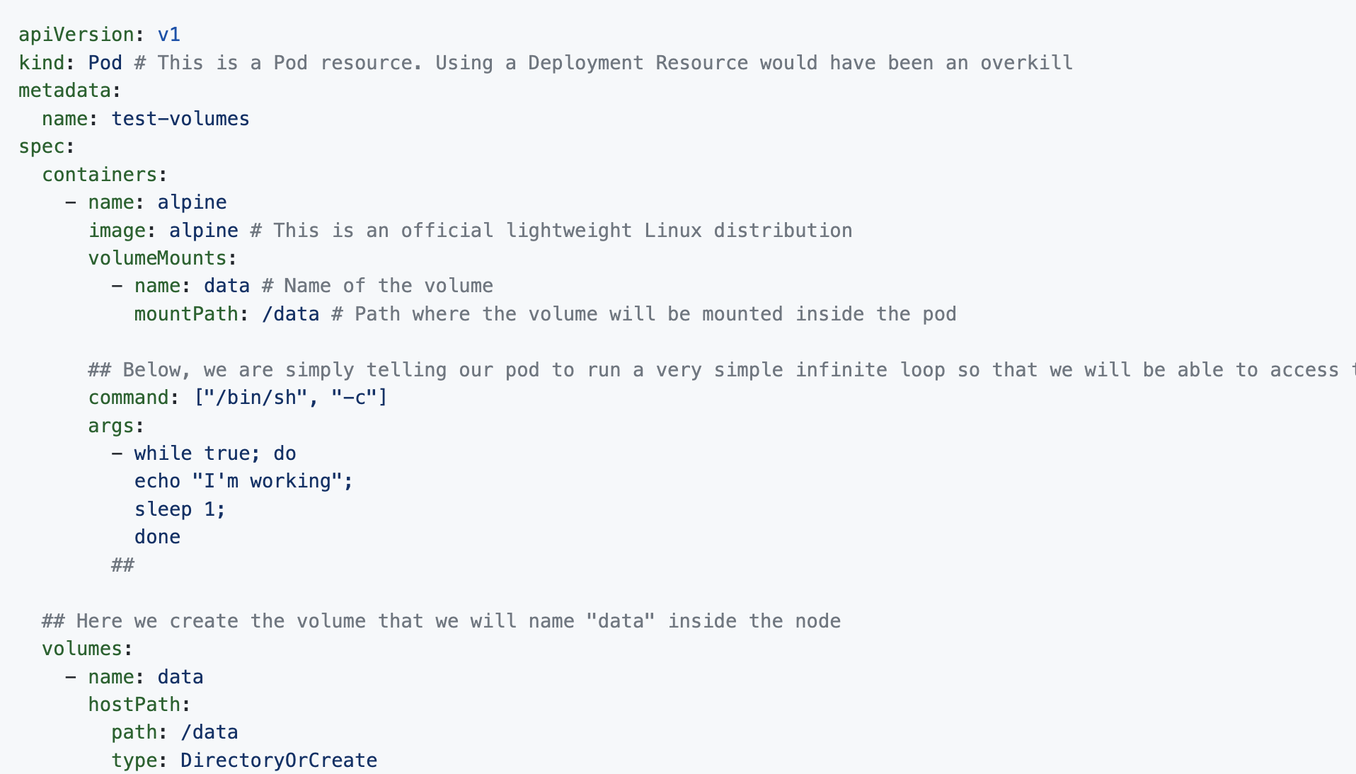
Hostpath
Hostpath are volumes that lives within a Node's filesystem. It's mounted afterward to each pods inside this node. Let's see an example. To do so, we will create a Pod resource, mount a volume and create data within it. Let's create a file called example_volumes_pod.yaml

Slide 4
Hostpath Now simply run: kubectl apply -f example_volumes_pod.yaml and wait for the Pod to be Running (it shouldn't take long).
Let's experiment the power of volumes:
Let's get inside the pod: kubectl exec -it test-volume -- sh
You should be prompted to a terminal, type: ls and you should see the following output
bin data dev etc home lib media mnt opt proc root run sbin srv sys tmp usr var
cd i nto data folder. If you ls into it, you should not see anything.
But let's create a new file: touch my_new_file.txt
👋 If you want, you can use vi to write something within the file.
Now exit the pod and delete it: kubectl delete pods test-volumes
Once you are done, recreate a Pod: kubectl apply -f example_volumes_pod.yaml
Again get inside this new pod: kubectl exec -it test-volume -- sh this time, you should see that data folder is not empty 😉
Eventhough Hostpath is the simplest way to use Volumes in Kubernetes, it is not the safest way to store data. What if your Node goes down? With Hostpath you would loose your data. Unless your data needs to live as long as your node is living, you might need to consider another way to using volumes: PersistentVolumes combines with PersistentVolumeClaims

Slide 5
Hostpath
Eventhough Hostpath is the simplest way to use Volumes in Kubernetes, it is not the safest way to store data. What if your Node goes down? With Hostpath you would loose your data. Unless your data needs to live as long as your node is living, you might need to consider another way to using volumes: PersistentVolumes combines with PersistentVolumeClaims

Slide 6
PersistentVolume & PersistentVolumeClaim
Why the combination of the two?
PersistentVolumes (PV) and PersistentVolumeClaims (PVC) work in pair. To ease the concept's comprehension, let's imagine there are two roles in your organization:
Cluster Administrator - In charge of building and maintaining your Kubernetes cluster
Cluster Developer - In charge of using the power of Kubernetes cluster to run his/her applications
Now let's explain PV and PVC:
PV - are created by the cluster administrator and it is the actual storage that is mounted to the cluster. It is usually an external service like awsElasticBlockStore (EBS) or azureDisk.
PVC - are used by cluster developers to "ask" for part of the storage contained in PV for their application

Slide 7
PersistentVolume & PersistentVolumeClaim
This way you are certain that each part of the service is completely fault tolerant. Let's now see an example, here are the steps we are going to follow:
Create a aws EBS volume
Create a PV
Create a PVC
Let's go ! 🏁

Slide 8
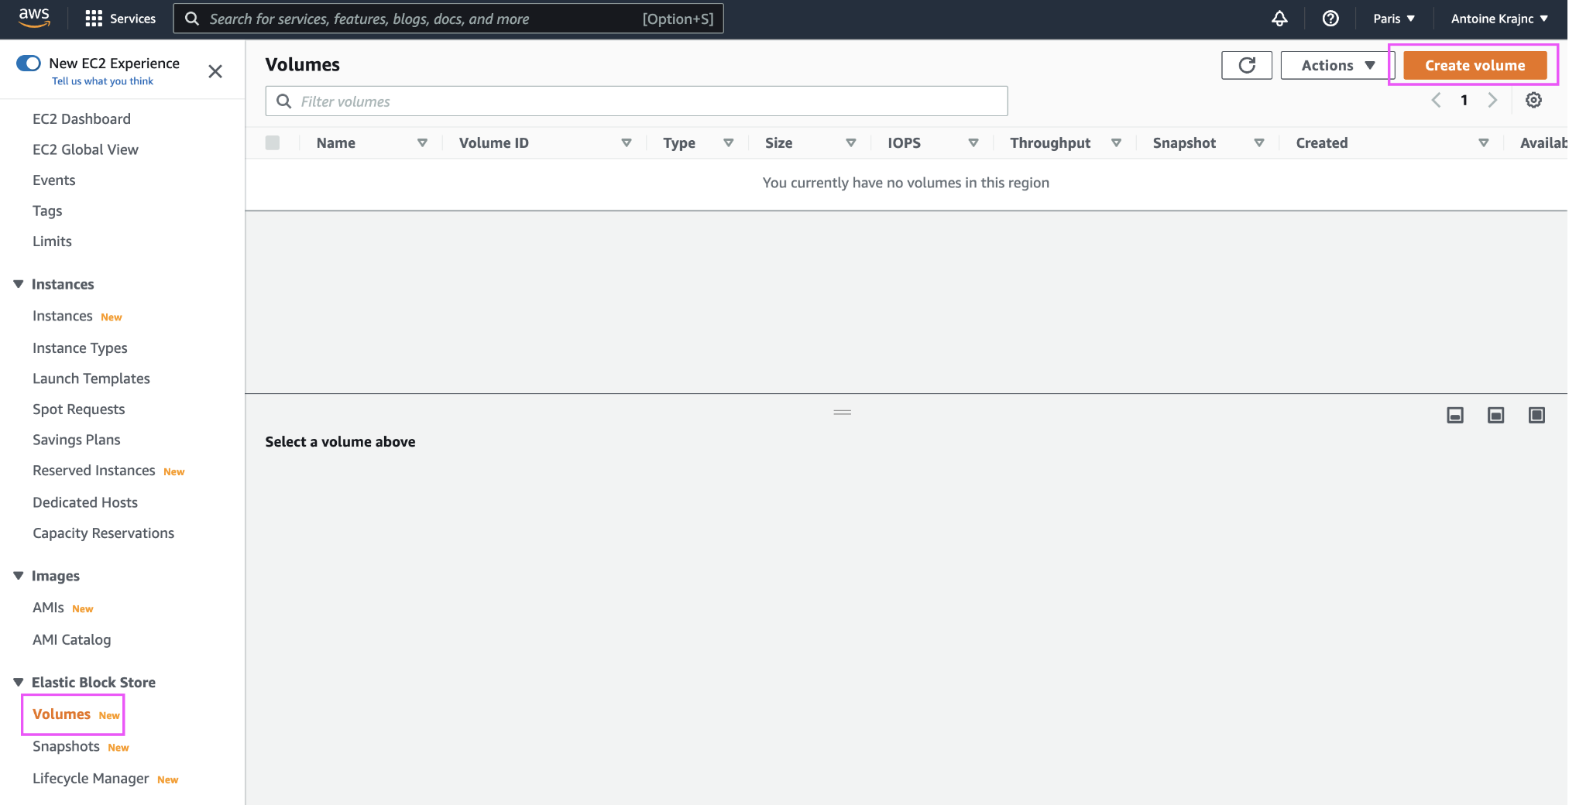
Create a aws EBS Volume
This step is very simple:
Go to EC2 service > Volumes (under Elastic Block Store section) > Create a volume

Slide 9
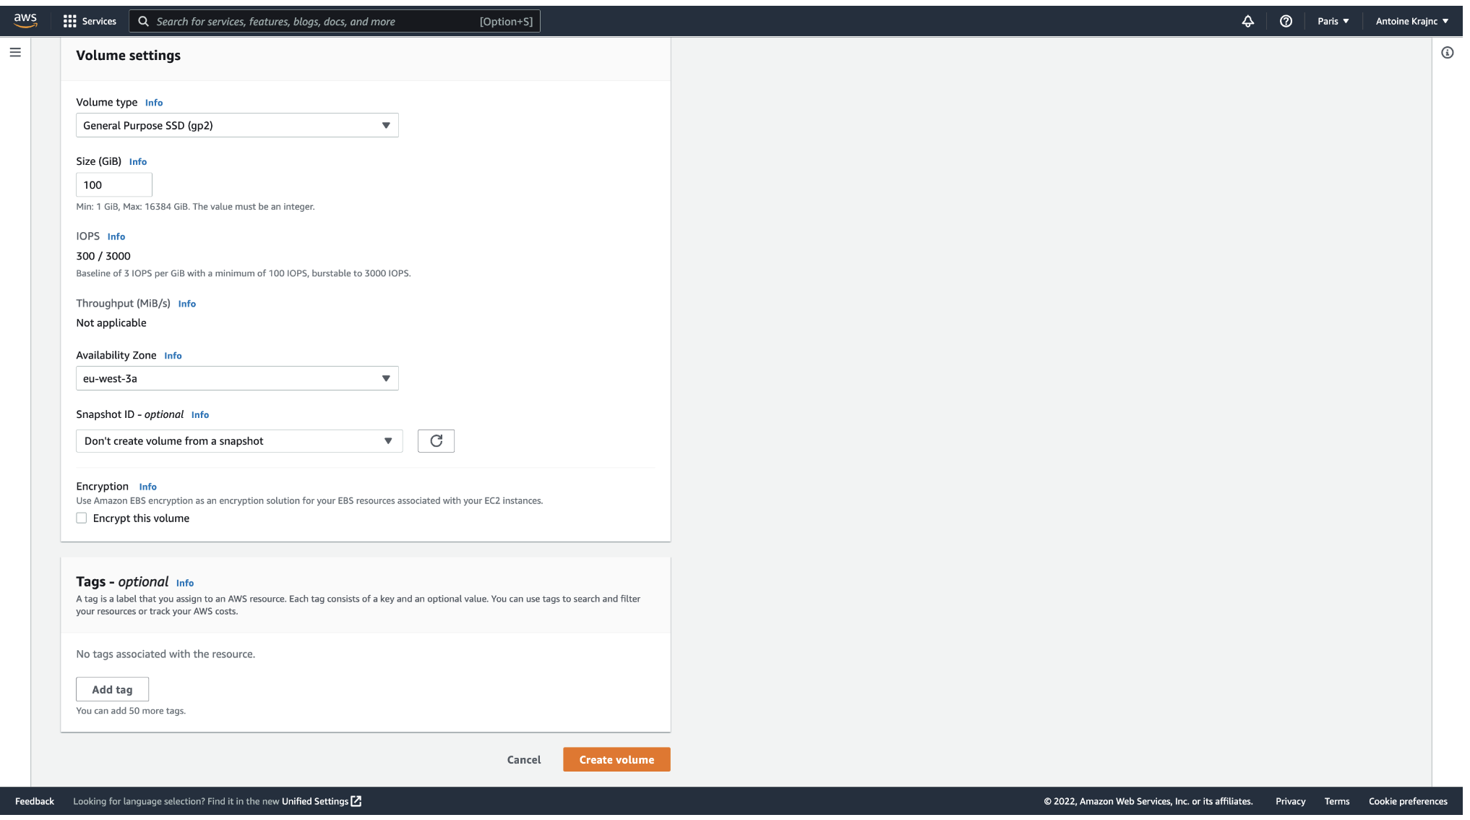
Create a aws EBS Volume
This step is very simple:
Set all the config you want for the volume (the # Go you need is important, you can leave the rest as default)

Slide 10
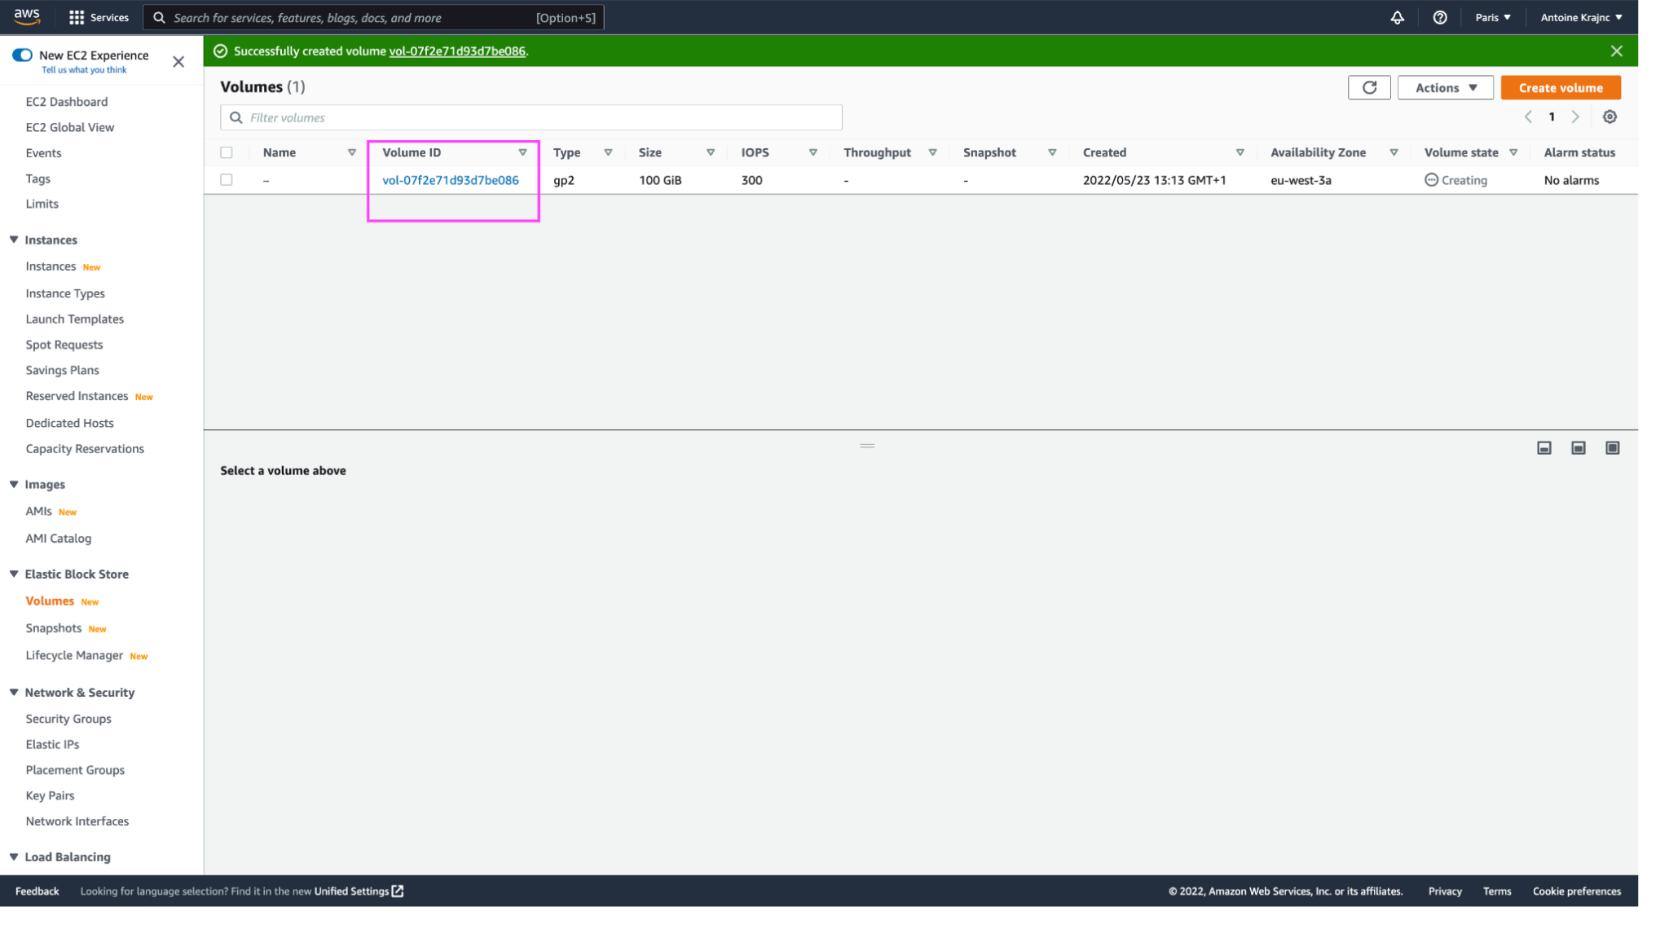
Create a aws EBS Volume
This step is very simple:
3. Simply keep the volume Id in mind for later usage

Slide 11
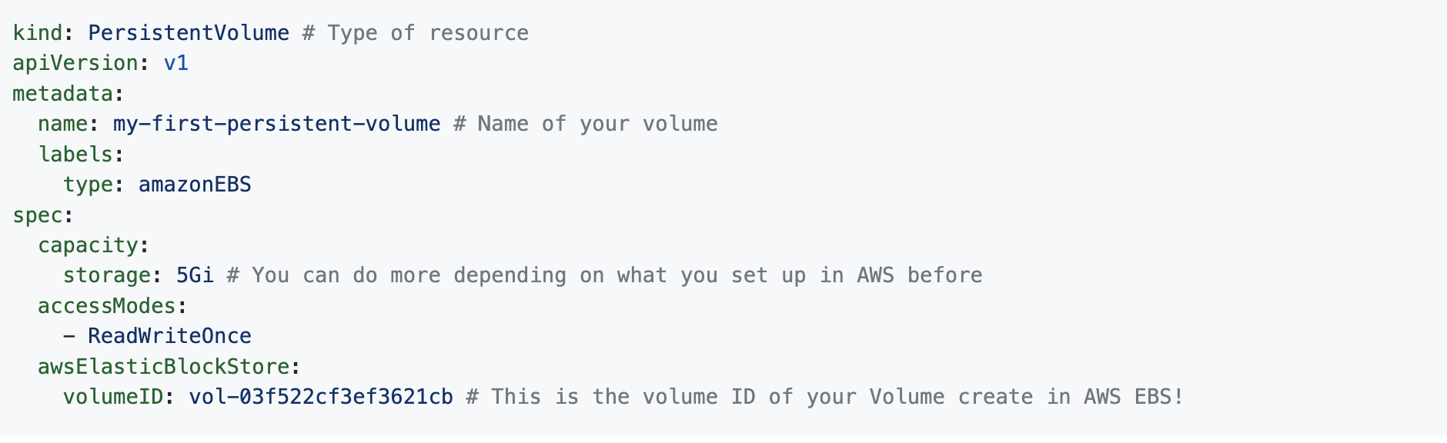
PersistentVolumes (PV)
Alright, now that we have everything we need, let's create our first file called persistent_volume.yaml with the following content:

Slide 12
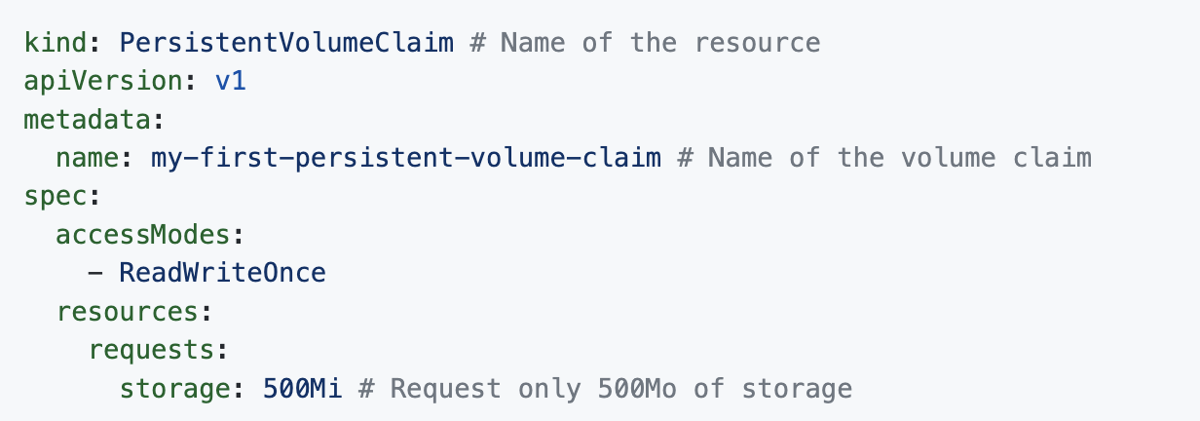
PersistentVolumeClaims (PVC)
Let's now "claim" a bit of that volume we created. Let's create persistent_volume_claim.yaml with the following content:

Slide 13
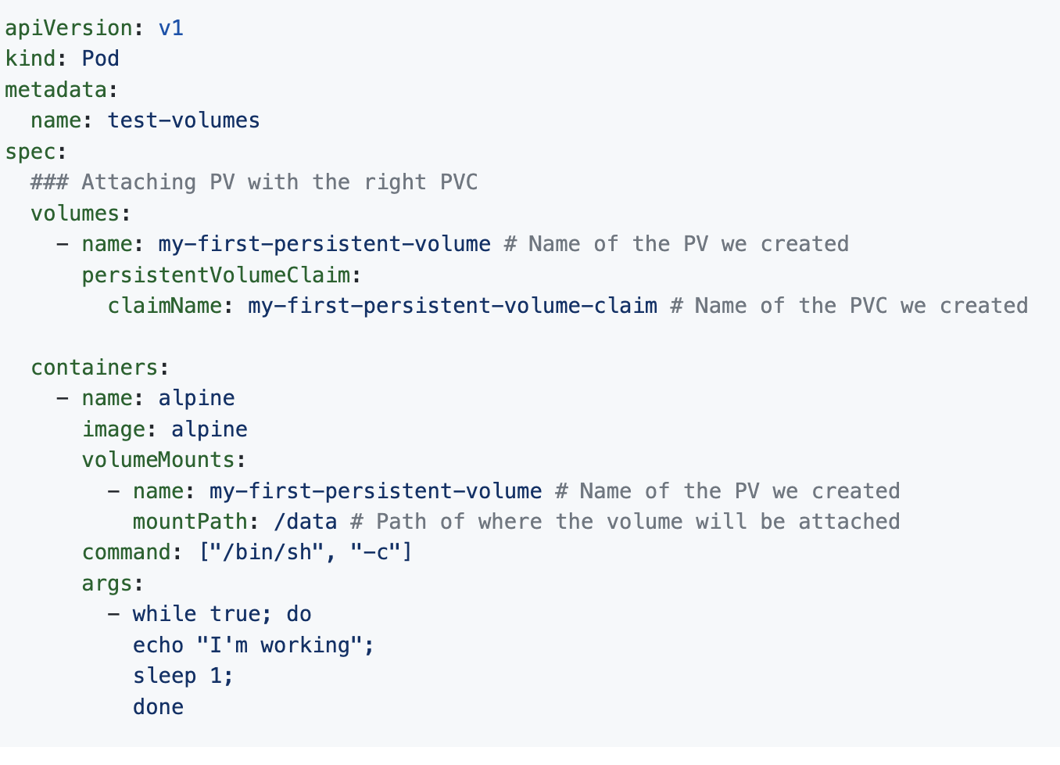
PersistentVolumeClaims (PVC)
Finally, let's put it all together to check whether everything worked the way we expected. To do that we will attach our volume to a pod to see if it worked correctly. Let's create example_pod.yaml with the following content:

Slide 14
PersistentVolumeClaims (PVC)
Again: kubectl apply -f example_pod.yaml
Now let's verify that everything works correctly:
List all PV: kubectl get pv you should see an output like this:
NAME CAPACITY ACCESS MODES RECLAIM POLICY STATUS CLAIM STORAGECLASS REASON AGE my-first-persistent-volume 5Gi RWO Retain Available 3m52s pvc-6bac1f92-637d-4d40-8b3e-7c552a300ae3 500Mi RWO Delete Bound default/my-first-persistent-volume-claim standard 3m47s
List all PVC: kubectl get pvc you should see an output like this:
NAME STATUS VOLUME CAPACITY ACCESS MODES STORAGECLASS AGE
my-first-persistent-volume-claim Bound pvc-6bac1f92-637d-4d40-8b3e-7c552a300ae3 500Mi RWO standard 4m1s

Slide 15
PersistentVolumeClaims (PVC)
Get inside the pod: kubectl exec -it test-volumes -- sh
ls into data
Create some data: touch my_great_file.txt
Delete pod: kubectl delete pods --all
Create a new pod: kubectl apply -f example_pod.yaml
my_great_file.txt should still be here 😉

